Slide 1

Capstone Project Play Store App Review Analysis
Atul Chune
Data Science Trainee, AlmaBetter

Slide 2

Introduction
Google Play Store offers 3.48 million apps, with 3,739 added daily, ensuring businesses succeed in the digital age. With a growing number of apps, businesses can find solutions to various problems, enhancing their online presence.
App reviews reveal patterns and trends from a business point of view, influencing app creation. Exploratory Data Analysis uncovers insights into sentiment and installations, enabling businesses to better understand and utilize these insights.
In-depth cleaning and generalized analysis yielded numerous insights into customer behavior and app usage in all category. The study aimed to determine the probability of app popularity among the audience
The purpose of our project is to gather and analyze detailed information on apps in the Google Play Store in order to provide insights on app features and the current state of the Android app market.
The Objective of the project to Explore and analyze the data to discover key factors responsible for app engagement and success.

Slide 3

Problem Statement
Find out the number of Apps per category
Which category of App has more installs?
Average rating of the apps
Which category of App is most popular on Play store based on Ratings
Number of Reviews per Category
What is the ratio of number of Paid apps and Free apps?
Which category of Apps from the Content Rating column are found more on Play store ?
What are the Top 10 installed apps in any category?
Distribution of apps based on its size
Top apps that are of free type
Top apps that are of paid type.
Android version based on each category
Most Revenue Generating Apps
Top Genres based on Installs
Percentage of Review Sentiments
Apps with the highest number of positive reviews
Apps with the highest number of negative reviews.
Apps with the highest number of neutral reviews.
Histogram of Subjectivity
How Content Rating affect over the App ?

Slide 4

Understanding Datasets
Dataset1- Playstore data
Dataset2- Users reviews
1.App: Name of App 2.Category: a group of apps that have similar features, functionality, and themes 3.Rating: a score or measurement of how good or popular it is out of 5 rating given by user 4.Reviews: Count of reviews given by users 5.Size: The memory size needed to install the application. 6.Installs: The number of times each application has been installed by users 7.Type: either it is paid or free 8.Price: if paid then price 9.Content Rating: This column specifies the intended audience for the app. Can be for teens, mature audience, or everyone. 10.Genres: The sub-category for each app. Example: for the Education category, this could be Education: Pretend Play, for example 11.Last Updated: Release date of the most recent update for the app 12.Current Ver: Current version of the app available on Play Store 13.Android Ver: The oldest version of Android OS supported by the app.
1.App: Name of the app. 2.Translated_Review: Either the original review in English, or a translated version if the original review is in another language. 3.Sentiment: The result of the sentiment analysis conducted on a review. The value is either Positive, Neutral or Negative. 4.Sentiment_Polarity: A value indicating the positivity or negativity of the sentiment, values range from -1 (most negative) to 1 (most positive). Sentiment polarity for an element defines the orientation of the expressed sentiment, i.e. it determines if the text expresses the positive, negative or neutral sentiment of the user about the entity in consideration. 5.Sentiment_Subjectivity: A value from 0 to 1 indicating the subjectivity of the review. Lower values indicate the review is based on factual information, and higher values indicate the review is based on personal or public opinions or judgements.

Slide 5

Dataset Preparation
Import Libraries: NumPy, Pandas, Seaborn and Matplotlib
Loading the data sets: Two datasets, First Play store app dataset and User Reviews dataset.
Data cleaning: Null values, Finding and removing Outliers, Removing duplicate data.
Data preparation: Filling the missing categorical values with mode and numerical values with median. Conversion of price, installs, reviews into numerical values.
Exploratory Data Analysis: Analyzing the data sets to summarize their main characteristics using statistical graphics and data visualizations method.

Slide 6
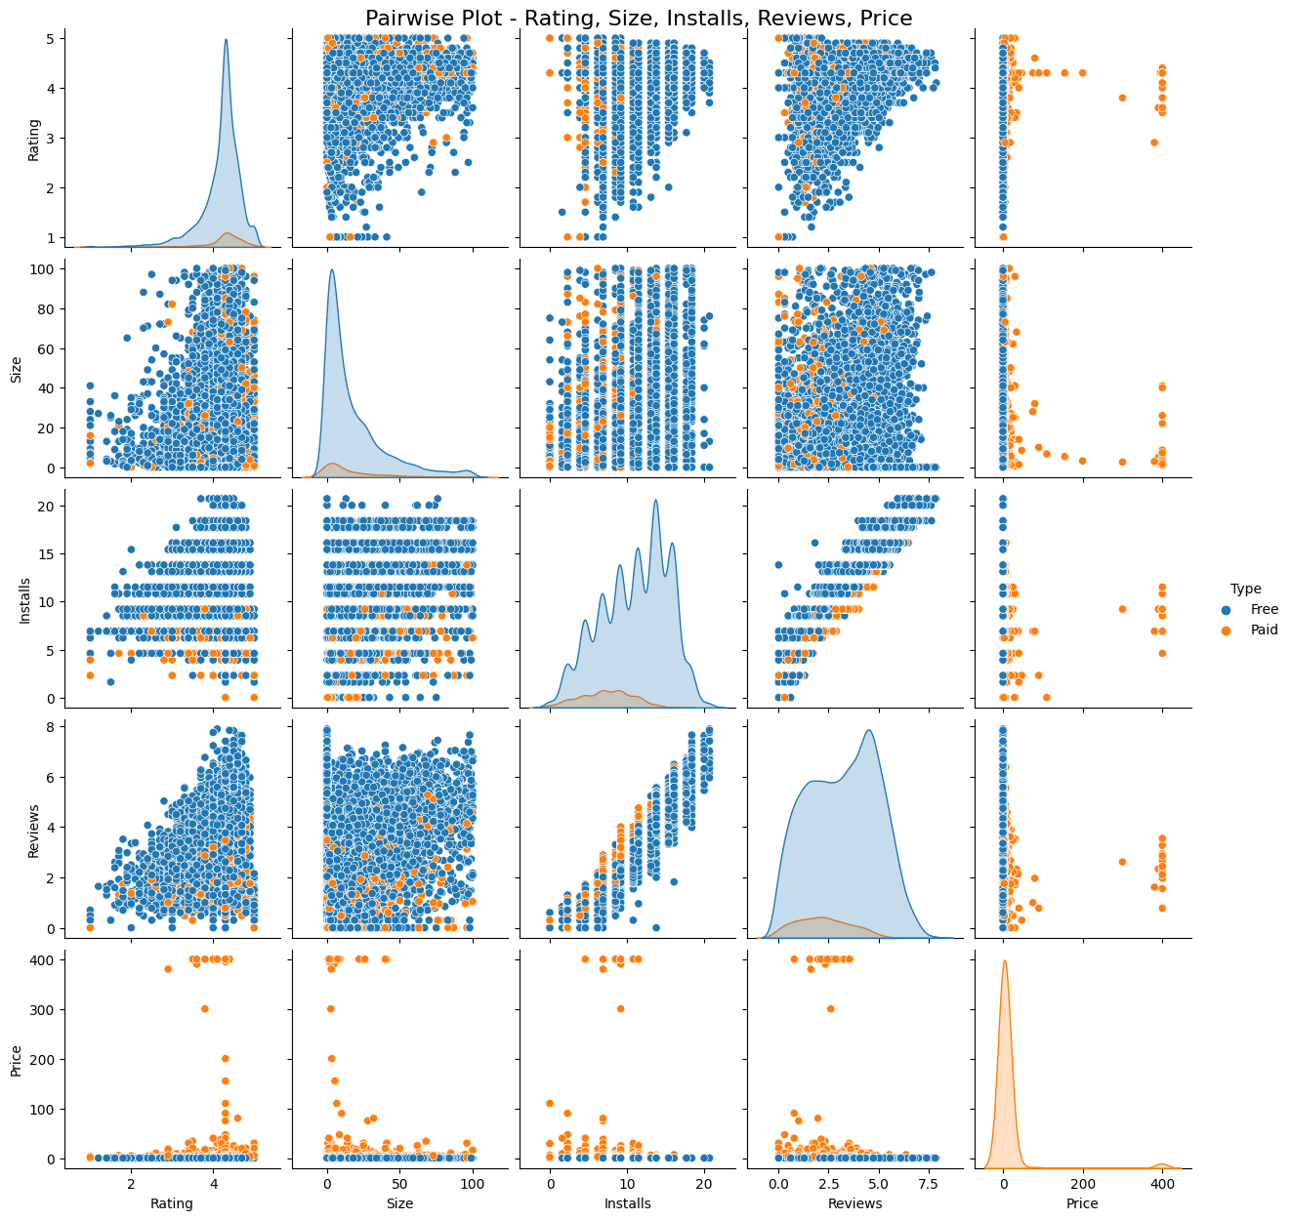
Data Exploration
Pair plot is used to understand the best set of features to explain a relationship between two variables or to form the most separated clusters. It also helps to form some simple classification models by drawing some simple lines or make linear separation in our data-set
FINDINGS :
Most of the App are Free.
Most of the Paid Apps have Rating around 4
As the number of installation increases the number of reviews of the particular app also increases.
Most of the Apps are light-weighted

Slide 7
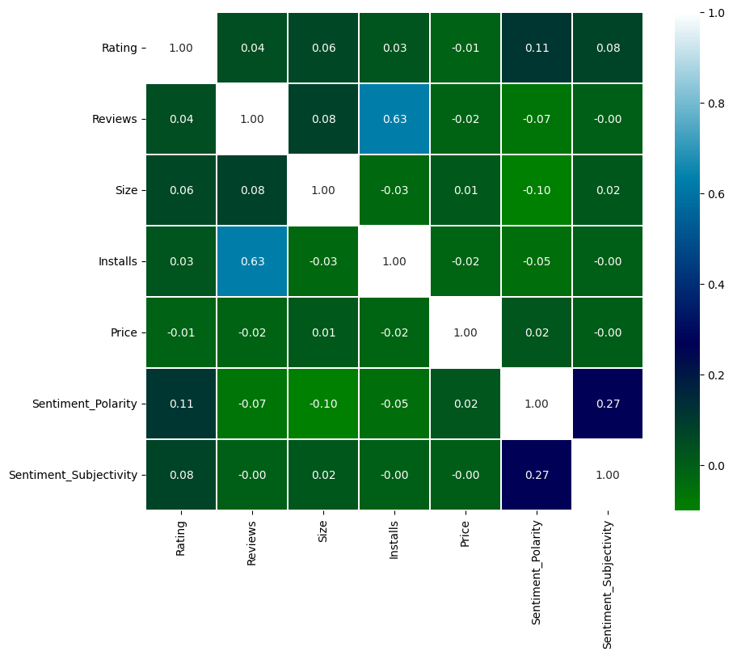
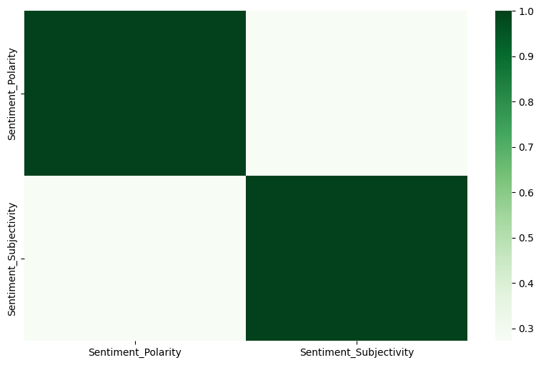
Number of Reviews is highly correlated with the number of Installs of the application
The Sentiment Polarity is slightly positively correlated with the Sentiment Subjectivity column. This indicates that as the average sentiment polarity increases, the sentiment subjectivity also increases.

Slide 8
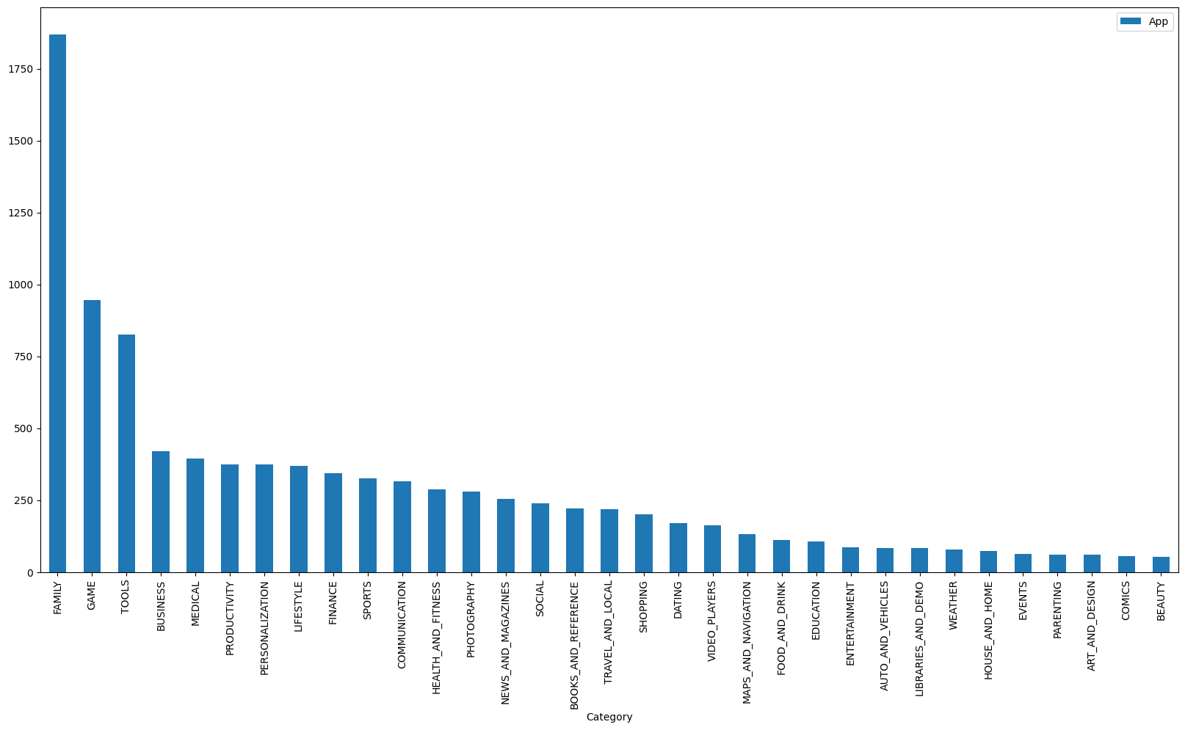
Data visualization
Chart - 1: Find out the number of Apps per category
Findings:
The above bar graph represents the distribution of number of apps in different categories in the Play Store. It can be inferred that FAMILY Category has the maximum number of Apps.

Slide 9
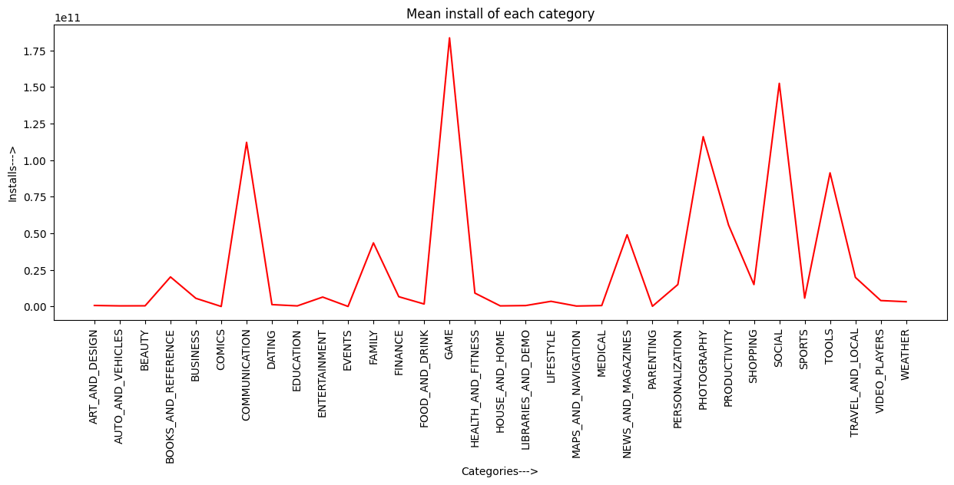
Chart - 2: Which category of App has more installs?
FINDINGS:
The Top 5 Categories according to number of installs are:-
Game ,Communication, Tools, Productivity , Social
When it comes to which categories have highest number of installs, the answer is a little bit different from the previous analysis. In this case, 'Game', and 'Social' have topped the list. They have more number of installs compared to any other category.

Slide 10
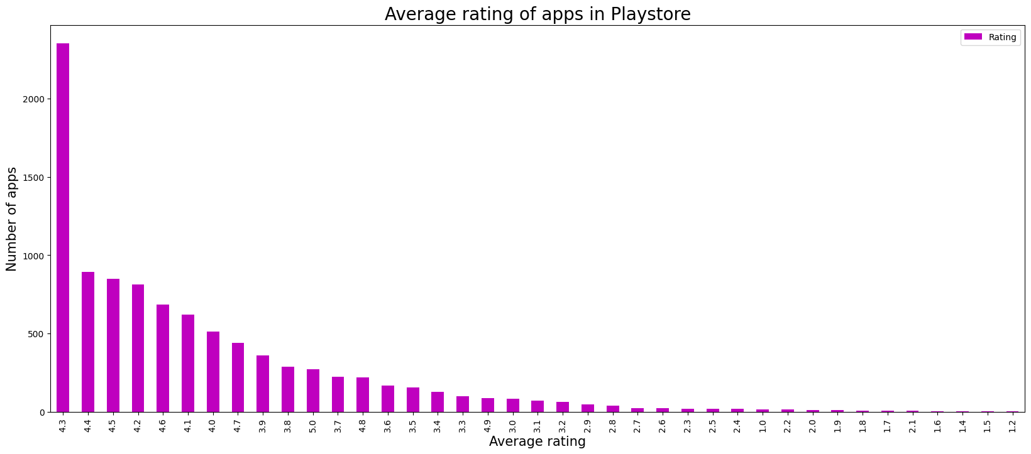
Chart - 3: Average rating of the apps
FINDINGS:
We can represent the ratings in a better way if we group the ratings between certain intervals. Here, we can group the rating as follows:
4-5: Top rated
3-4: Above average
2-3: Average
1-2: Below average

Slide 11
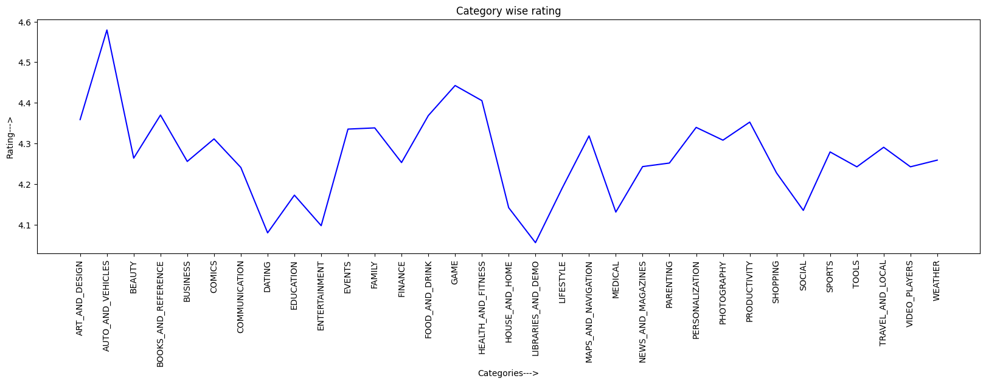
Chart - 4: Which category of App is most popular on Play store based on Ratings
FINDINGS:
Rating is highest for AUTO_AND_VEHICLES and GAME category apps.
Rating is low for LIBRARIES_AND_DEMO and DATING category apps

Slide 12
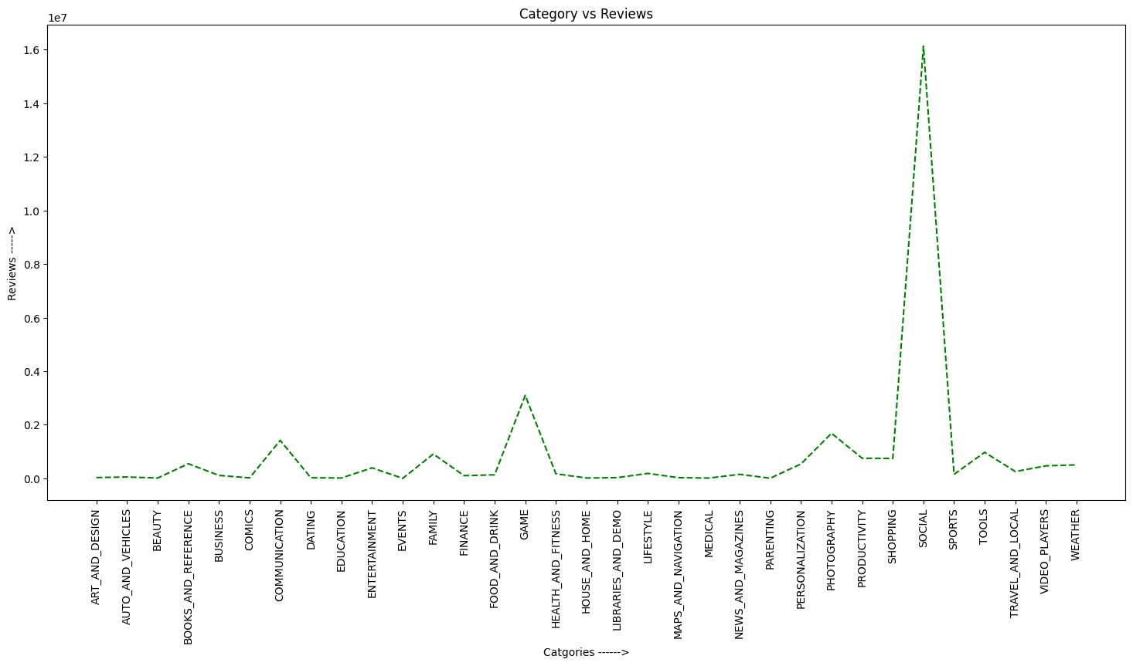
Chart - 5 : Number of Reviews per Category
FINDINGS:
Social category has most number of reviews

Slide 13
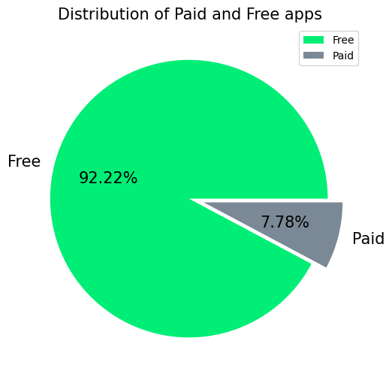
Chart - 6 : What is the ratio of number of Paid apps and Free apps?
Findings:
From the above graph we can see that 92% of apps in google play store are free and 8%are paid.

Slide 14
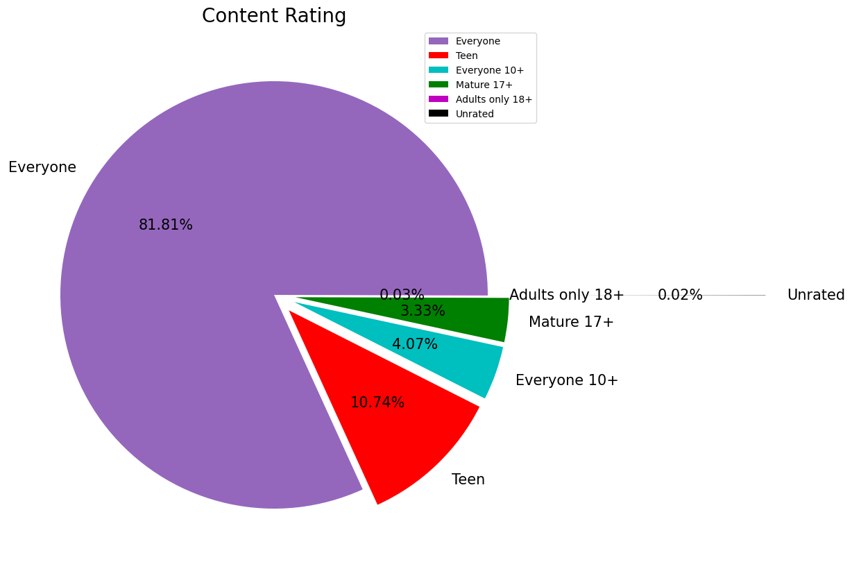
Chart - 7 : Which category of Apps from the Content Rating column are found more on Playstore ?
FINDINGS:
From above graph we can conclude that App Having 'Content Rating' - Everyone is having maximum number installation of 100.228B.
Also we can conclude that there are 4.29B installation for application having Content Rating of Everyone 10+.
We can also conclude that there are no such noticeable installation for Application having Content Rating of Adults only 18+ and Unrated.

Slide 15
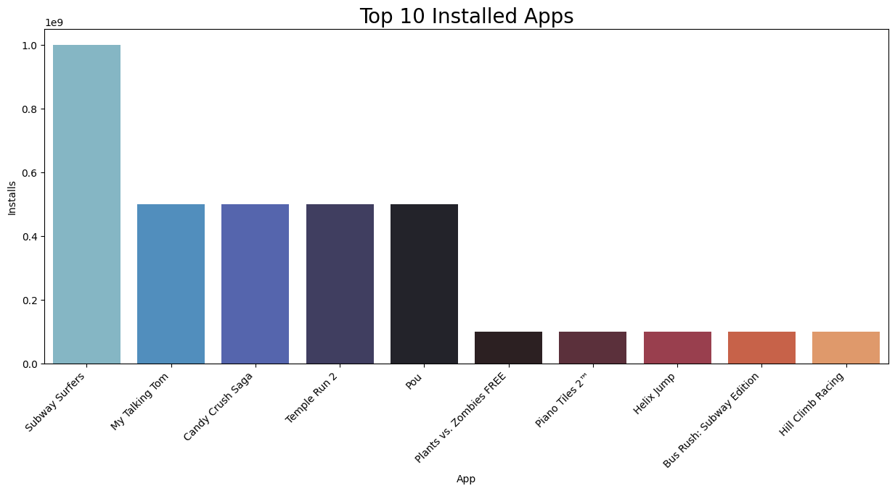
Chart - 8 : What are the Top 10 installed apps in any category?
FINDINGS:
From the above graph we can see that in the Game category Subway Surfers, Candy Crush Saga, Temple Run 2 has the highest installs. In the same way we by passing different category names to the function, we can get the top 10 installed apps.

Slide 16
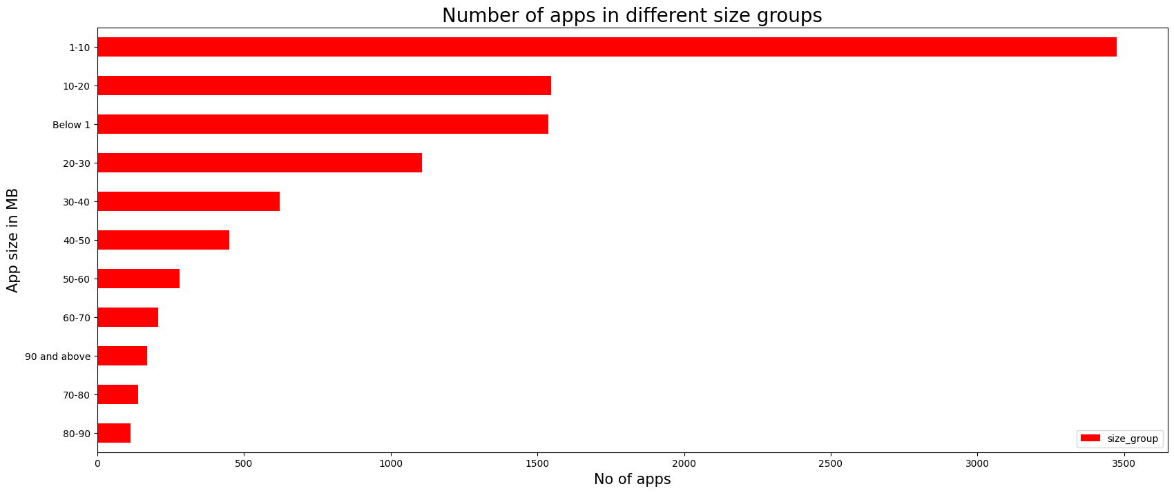
Chart - 9 : Distribution of apps based on its size
Finding 1 : The sizes of the majority of the apps range in between 1 and 20 MB.

Slide 17
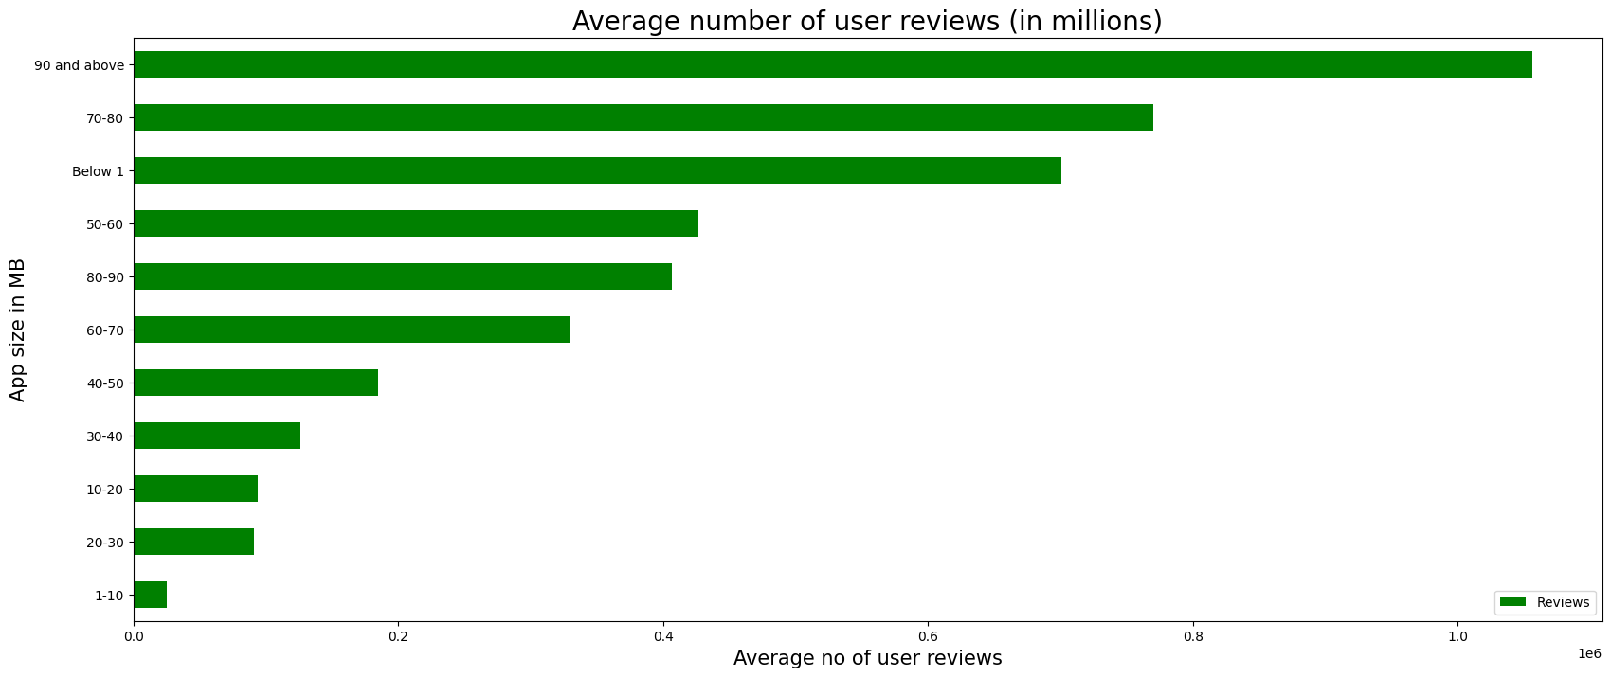
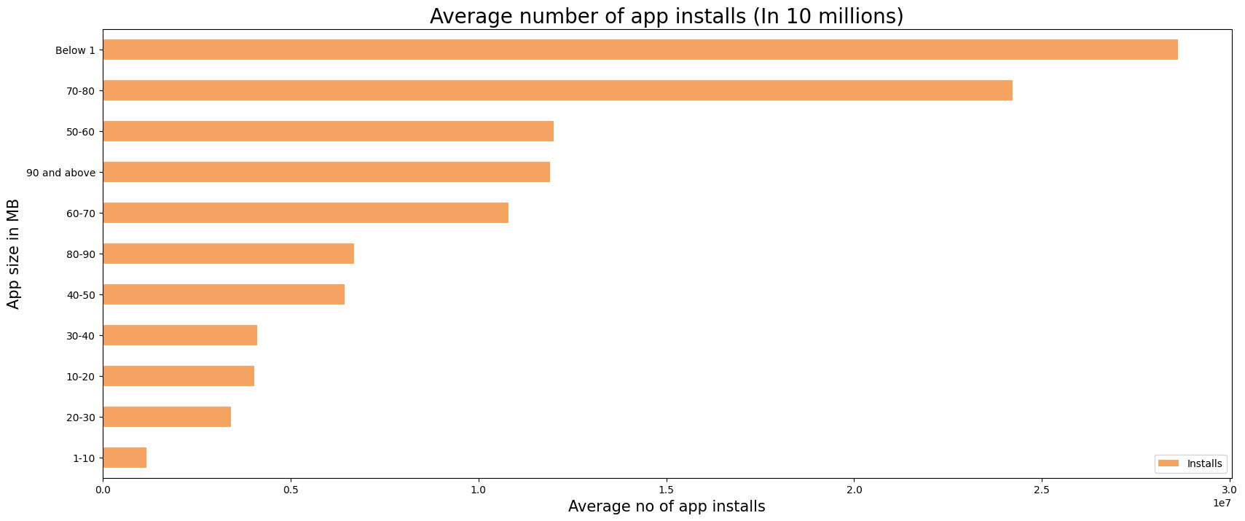
FINDING 2: The apps which are smaller in size on average have lower no of app installs and user reviews

Slide 18
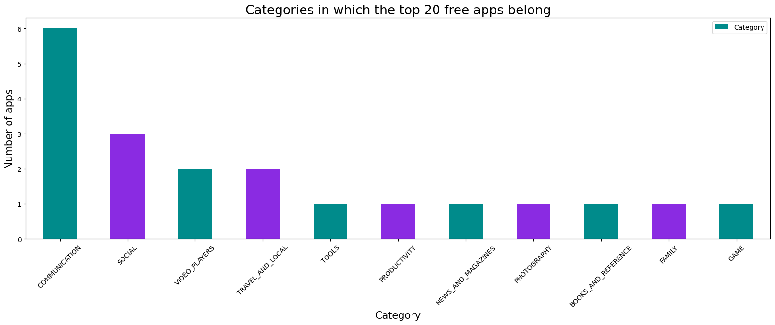
Chart - 10 : Categories in which the top 20 free apps belong
FINDINGS: Communication category contains most number of free apps in top 20 lists of free apps.

Slide 19
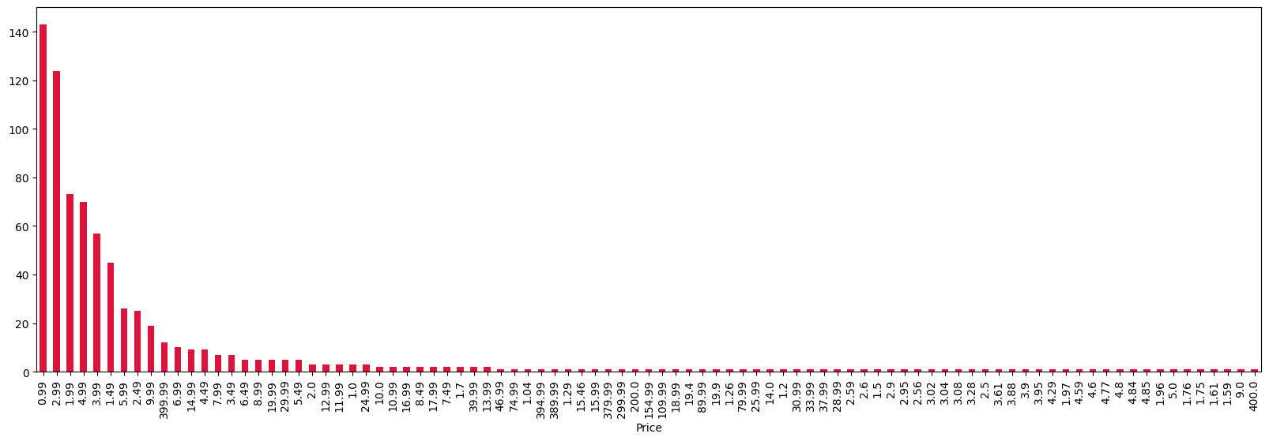
Chart - 11 : Number of apps that can be installed at a particular price
FINDINGS:
The paid apps charge the users a certain amount to download and install the app. This amount varies from one app to another.
There are a lot of apps that charge a small amount whereas some apps charge a larger amount. In this case the price to download an app varies from USD 0.99 to USD 400.
In order to select the top paid apps, it won't be fair to look just into the number of installs. This is because the apps that charge a lower installation fee will be installed by more number of people in general.

Slide 20
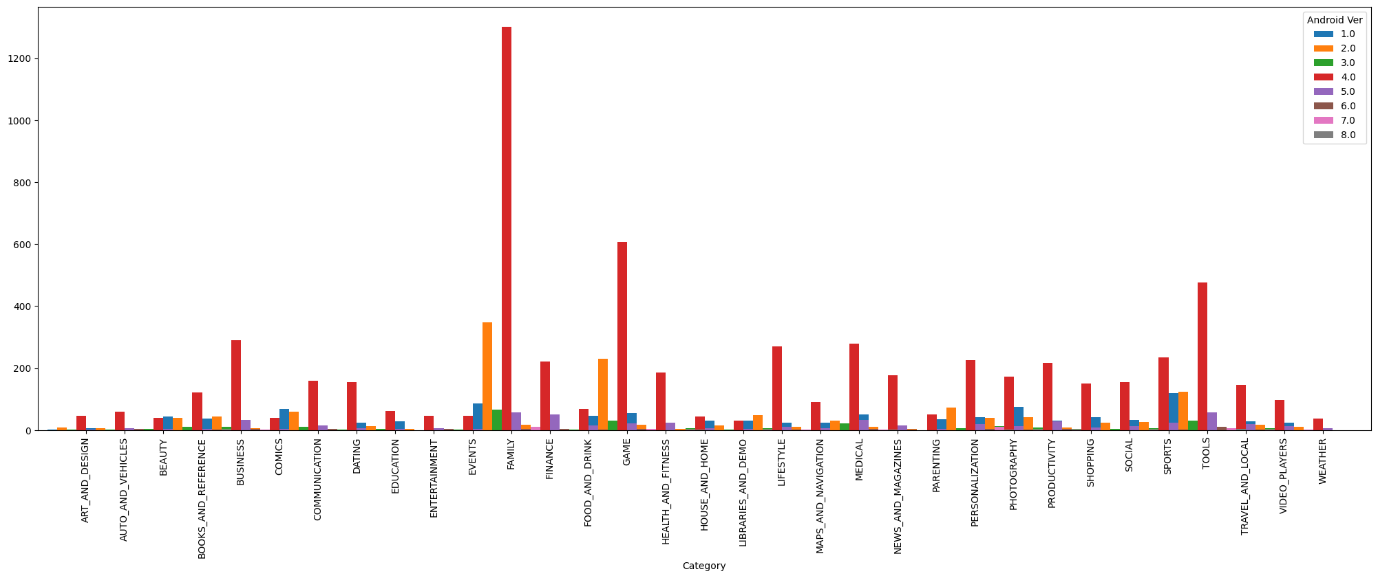
Chart - 12 : Android version based on each category
FINDINGS:
It is clearly evident from the above plot that majority of the app are working on Android_version 4.0 and up

Slide 21
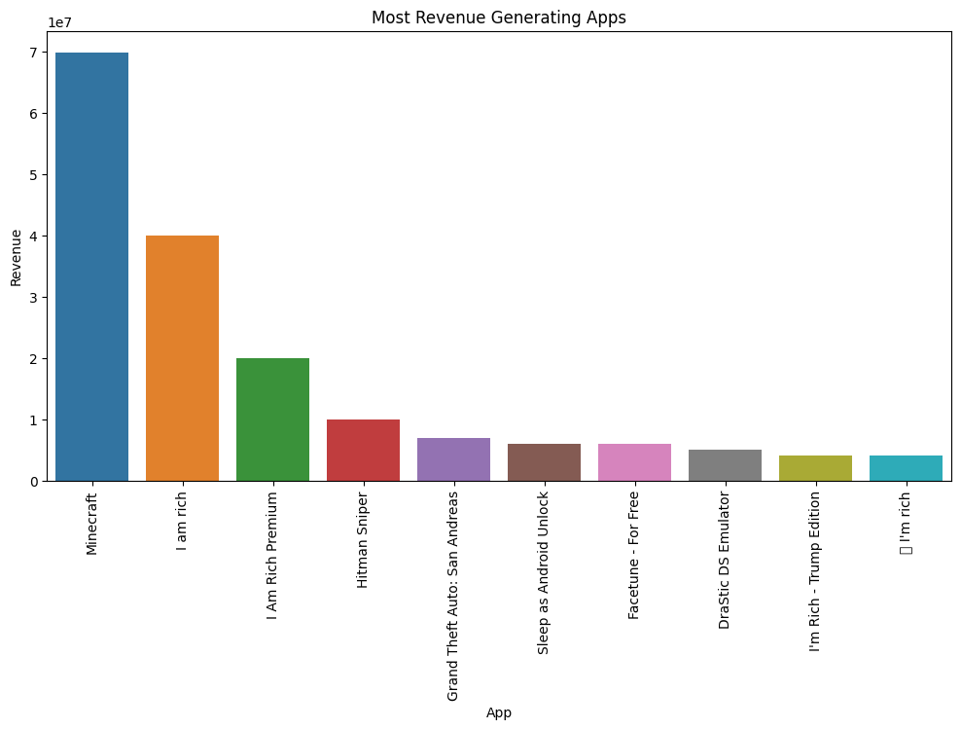
Chart - 13: Most Revenue Generating Apps
Findings:
This visualization tells us that Minecraft generates the most revenue i.e. approximately 70 million dollars

Slide 22
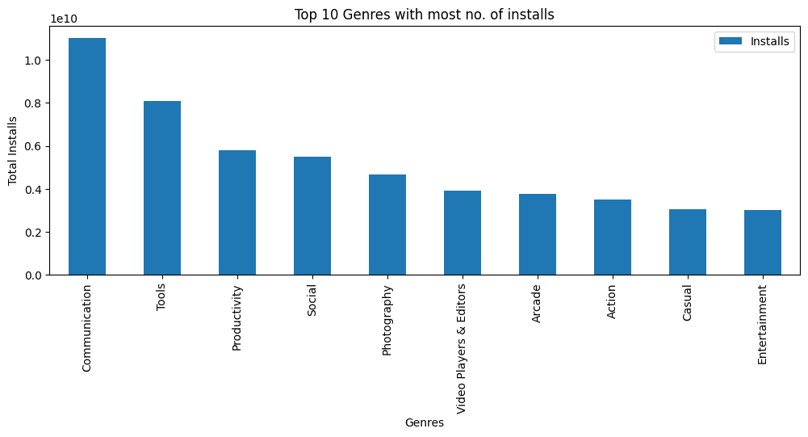
Chart - 14 : Top Genres based on Installs
FINDINGS:
By looking at the visualization we can say that Communication genre has the most number of installs. With that we can also say that apps from this genre are downloaded more than the other genres.
So, this marks the end of the visualizations for the Apps Dataframe and now we will begin with the visualizations for the Reviews Dataframe.

Slide 23
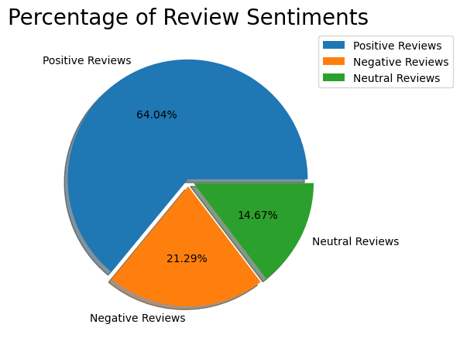
Chart - 15: Percentage of Review Sentiments
FINDINGS:
Positive reviews are 64.30%
Negative reviews are 22.80%
Neutral reviews are 12.90%

Slide 24
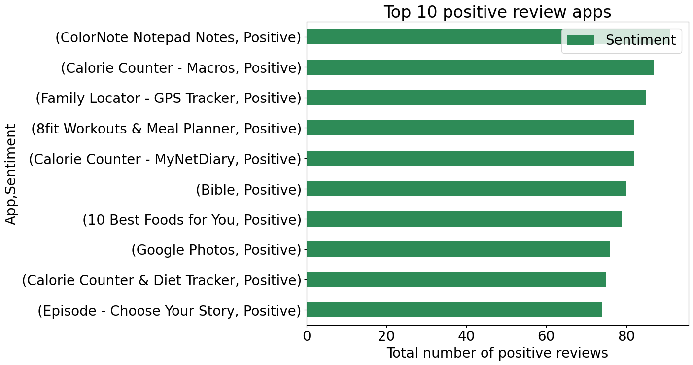
Chart - 16 : Apps with the highest number of positive reviews
FINDINGS:
The visualization tells us that the app with the highest positive reviews is ColorNote Notepad Notes

Slide 25
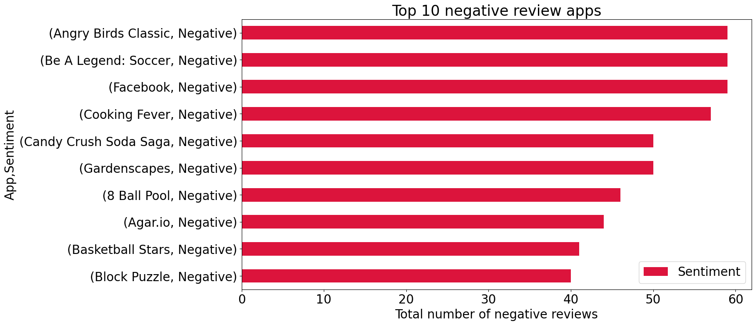
Chart - 17 : Apps with the highest number of negative reviews.
FINDINGS:
The visualization tells us that the app with the highest negative reviews is Angry Birds Classic

Slide 26
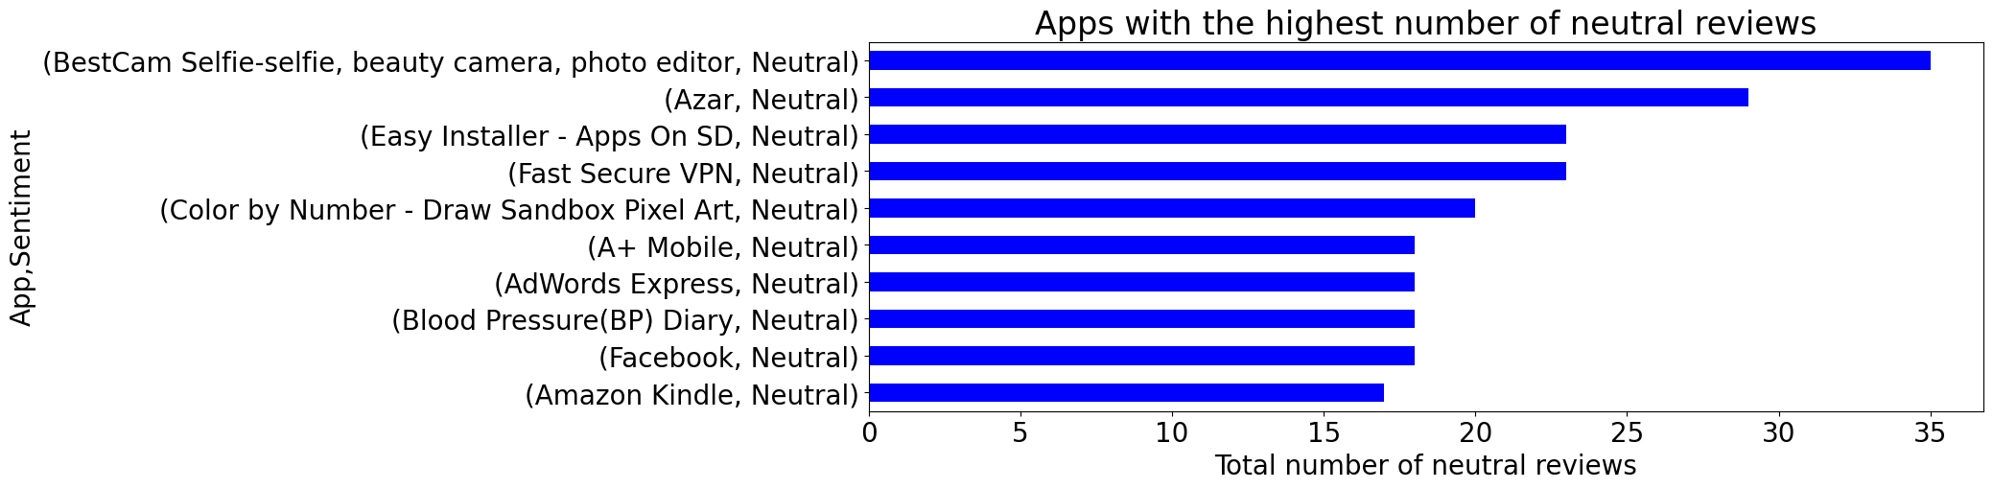
Chart - 18 : Apps with the highest number of neutral reviews
FINDINGS:
The visualization tells us that the app with the highest negative reviews is BestCam Selfie-selfie, beauty camera, photo editor

Slide 27
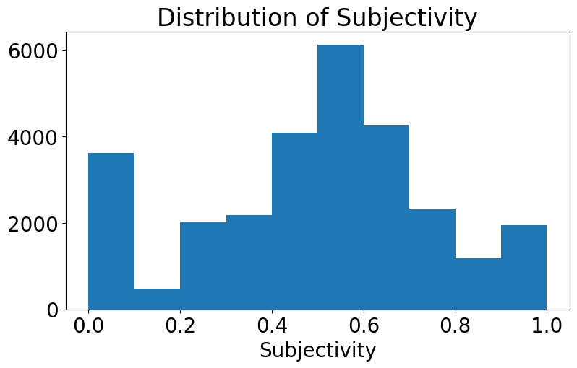
Chart - 19 : Histogram of Subjectivity
FINDINGS:
0 - objective(fact), 1 - subjective(opinion)
It can be seen that maximum number of sentiment subjectivity lies between 0.4 to 0.7. From this we can conclude that maximum number of users give reviews to the applications, according to their experience

Slide 28
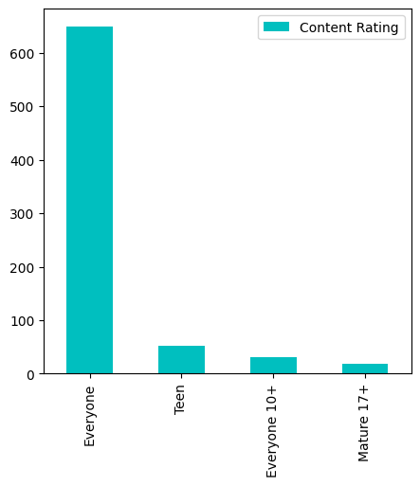
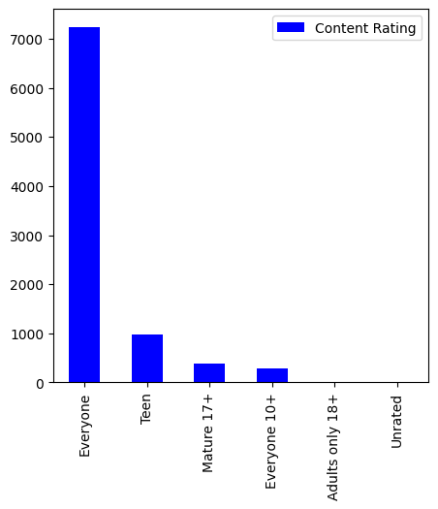
Chart - 20 : How Content Rating affect over the App
1) Paid App Content Rating 2) Free App Content Rating
FINDINGS:
Most Number of content ratings which got on Google Play Store can be used by everyone. The remaining apps have various age restrictions to use it

Slide 29

CONCLUSION
Percentage of free apps = ~92%
Percentage of apps with no age restrictions = ~82%
Most competitive category: Family
Category with the highest average app installs: Game
Percentage of apps that are top rated = ~80%
Family, Game and Tools are top three categories having 1906, 926 and 829 app count.
Tools, Entertainment, Education, Business and Medical are top Genres.
8783 Apps are having size less than 50 MB. 7749 Apps are having rating more than 4.0 including both type of apps.
There are 20 free apps that have been installed over a billion times.
Minecraft is the only app in the paid category with over 10M installs. This app has also produced the most revenue only from the installation fee.
Category in which the paid apps have the highest average installation fee: Finance
The median size of all apps in the play store is 12 MB.
The apps whose size varies with device has the highest number average app installs.
The apps whose size is greater than 90 MB has the highest number of average user reviews, ie, they are more popular than the rest.
Helix Jump has the highest number of positive reviews and Angry Birds Classic has the highest number of negative reviews.
Overall sentiment count of merged dataset in which Positive sentiment count is 64%, Negative 22% and Neutral 13%.

Slide 30
THANK YOU

